Slide 1
Ealing Deanery
Our Multi Faith Landscape

Slide 2
Ealing Deanery Breakdown
Notes:
Harrow lowest at 37% Christian

Slide 3
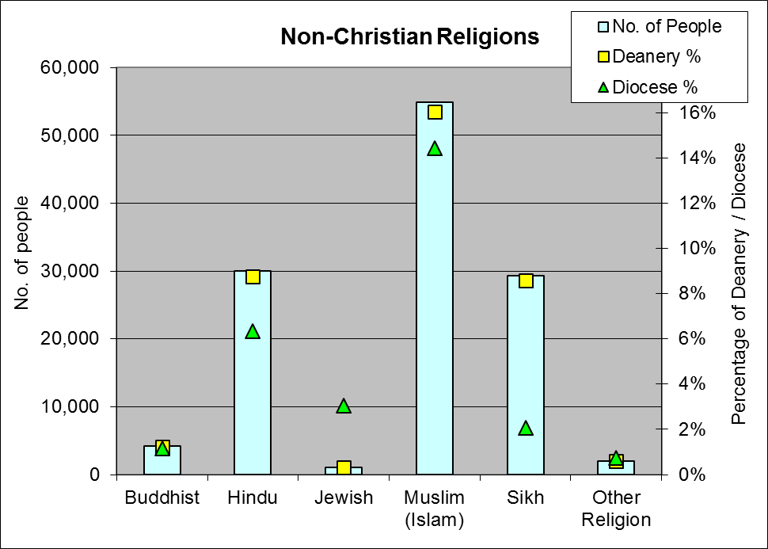

Slide 4
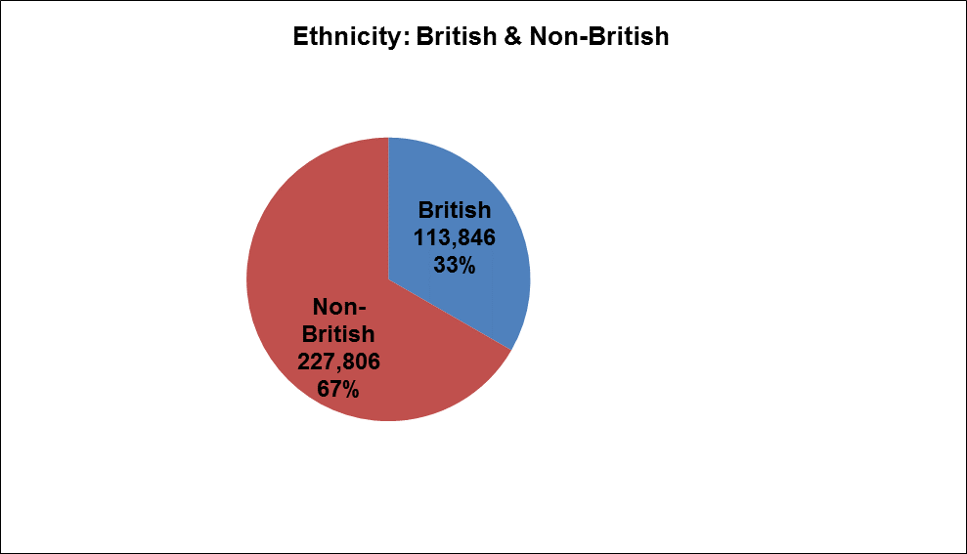
Notes:
Greater proportion of non British than Brent (55%) and Harrow (64%)

Slide 5
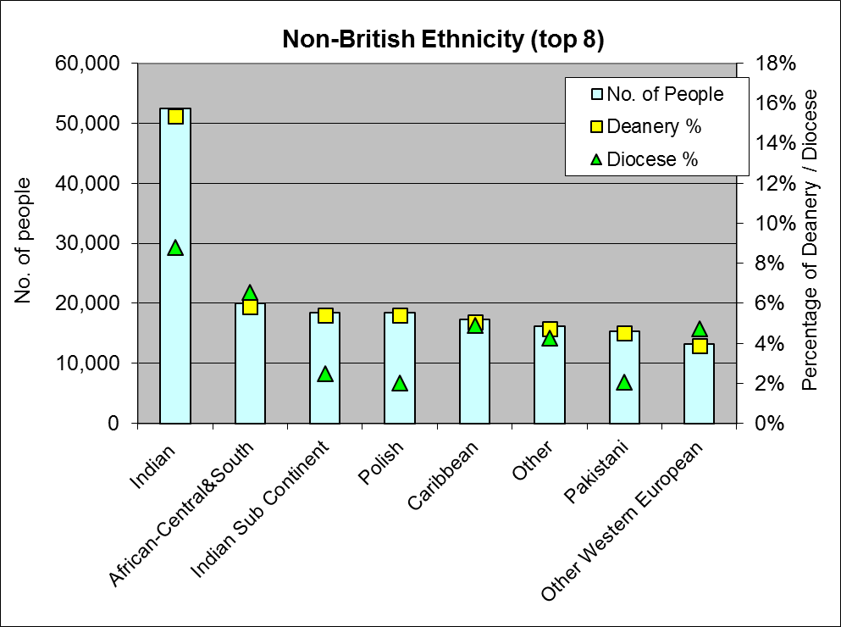

Slide 6
Notes:
More stable than Brent: long established South Asian population

Slide 7
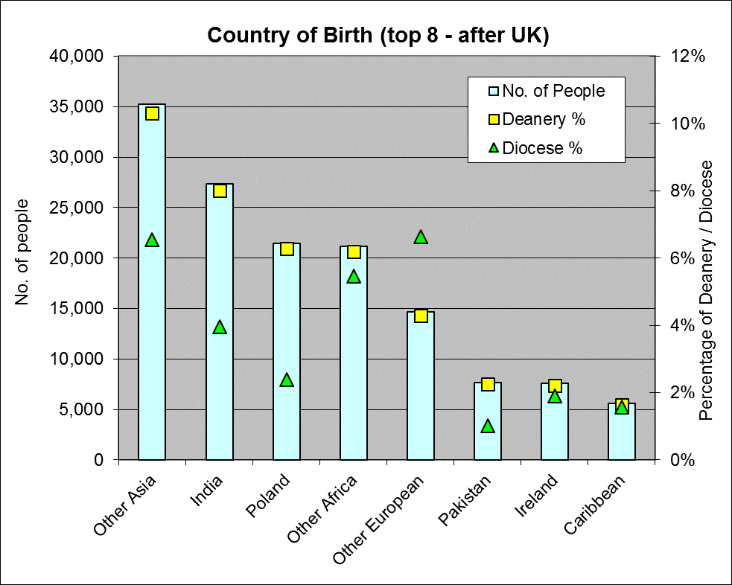
Notes:
Contrast with Harrow

Slide 9
Ealing Council 2012
Ealing is also recognised as the 6th most diverse borough in terms of faith. Those following Christianity remain the largest majority in the borough, followed by Muslims, Hindus, and Sikhs. However, the proportion of Christians has fallen between 2006-10 while those of Muslims has increased in the same period, doubling from 11% in 2006 to 22% in 2010 .

Slide 10
Hindu Presence in the Deanery
Range 24% to 2% (Brent 50% to 2%, Harrow 43%-12.5%)
London Diocese Average 4.89%
Of 31 parishes, 9 over 10% (Brent of 21, 11 over 10%; Harrow of 22, 11 over 20%)

Slide 11
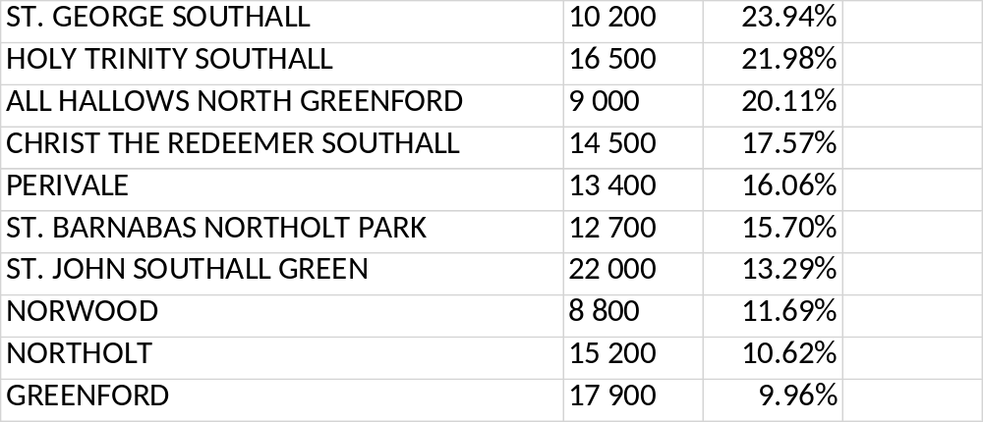
Main Hindu Presence

Slide 12
Muslim Presence in Ealing Deanery
Range 29% to 3% (Harrow, 20% to 7%, Brent 29% to 9%)
Diocese of London Average 12.5%
Of 31 parishes 17 over Diocesan average of 12.5% (Brent Of 21 parishes, 16 more than 15% or 1 in 7 of the population, Harrow 6 over average)

Slide 13
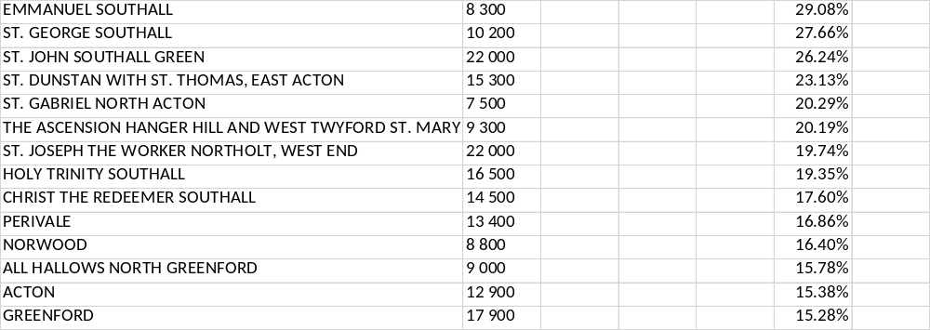
Parishes with High Muslim Presence

Slide 14
Sikh Presence in Ealing
Range 39% - 0.86% (Harrow 2.25 to 0.5, Brent 3.4% to less than O.1%)
Diocese of London average 1.54%
Of 31 parishes, 25 above London average.

Slide 15
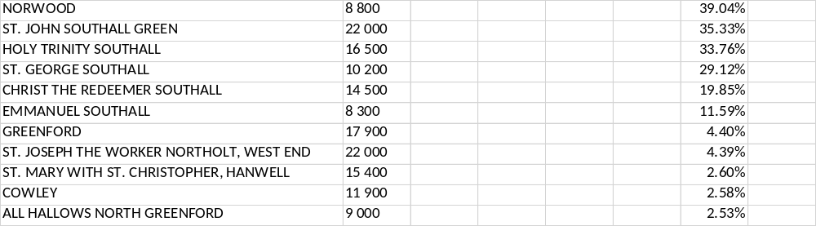
Sikh Presence in Ealing

Slide 16
Jewish Presence in Ealing
Only 3 parishes above 1% (Harrow 22% to 0.7%, Brent 4.1% to 0.1%)
London Diocese Average 2.82%

Slide 17
Top Jewish Parishes in Ealing
The Ascension HANGER Hill
19 000
48.99%
1.17%
ST. PETER MOUNT PARK EALING
7 500
51.15%
1.16%
ALL SAINTS EALING
5 800
49.15%
1.00%

Slide 18
Buddhist Presence in Ealing
Range 4.5% to 0.25% (Harrow 2% to 0.5% ,Brent 2.35% to 0.57%)
London Diocese average 1.18%
Of 31 parishes, 16 above London average

Slide 19
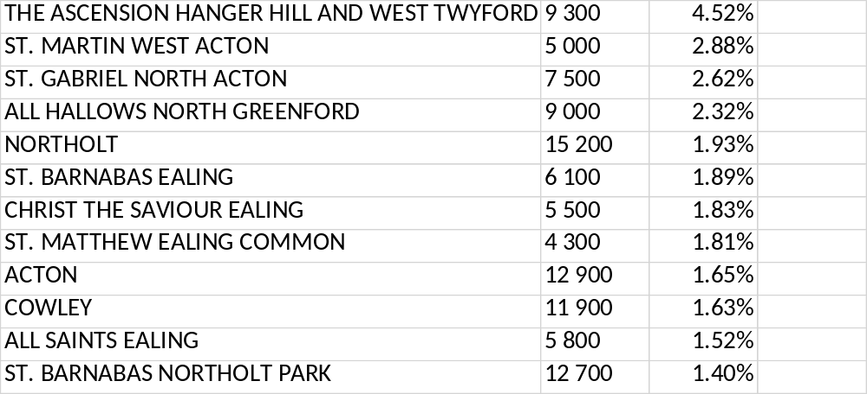
Top Buddhist Parishes in Ealing

Slide 20
Christian Presence in Ealing
Range 55% to 11.6% (Harrow 47.36 to 27.08% , Brent 55.91% to 24.71%)
London Diocese average 44.81%
Out of 31, only 7 below London Average (Harrow 16 below London Average, and all below 50%, Brent 10 parishes below London average, and 15 below 50%)

Slide 21
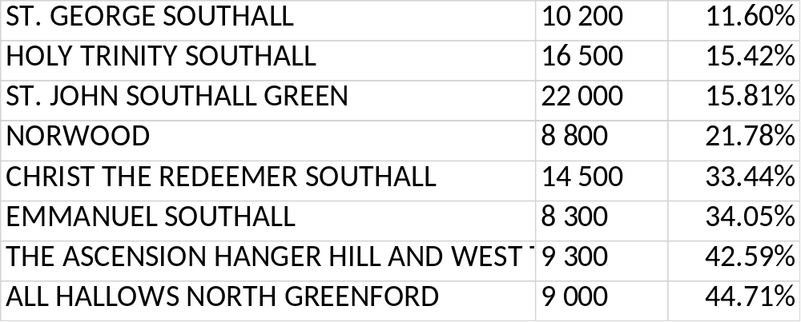
Christian Presence in Ealing Lowest

Slide 22
Other Religious Groups
Other recognised religious Groupings: Zorastians, Bahai.
Pagans, humanists,
NRM’s: Mormons, Seventh Day Adventist, Jehovah Witnesses, Shincheonji Church of Jesus the Temple of the Tabernacle of the Testimony (New Heaven and New Earth) ; Brotherhood of the Cross and Star (Nigerian; Olumba Olumba Obu)

Slide 23
What issues does this raise for us in our parishes and in terms of the London Church?
What would you describe as the key issues in your particular Parish in terms of engagement with people of other religious/faith backgrounds?
What issues does this raise for us in terms of our Christian presence in Brent (Capital Vision 2020) and our relations with people of other faiths or ideological persuasions?

Slide 24
London Inter Faith Centre

Slide 25
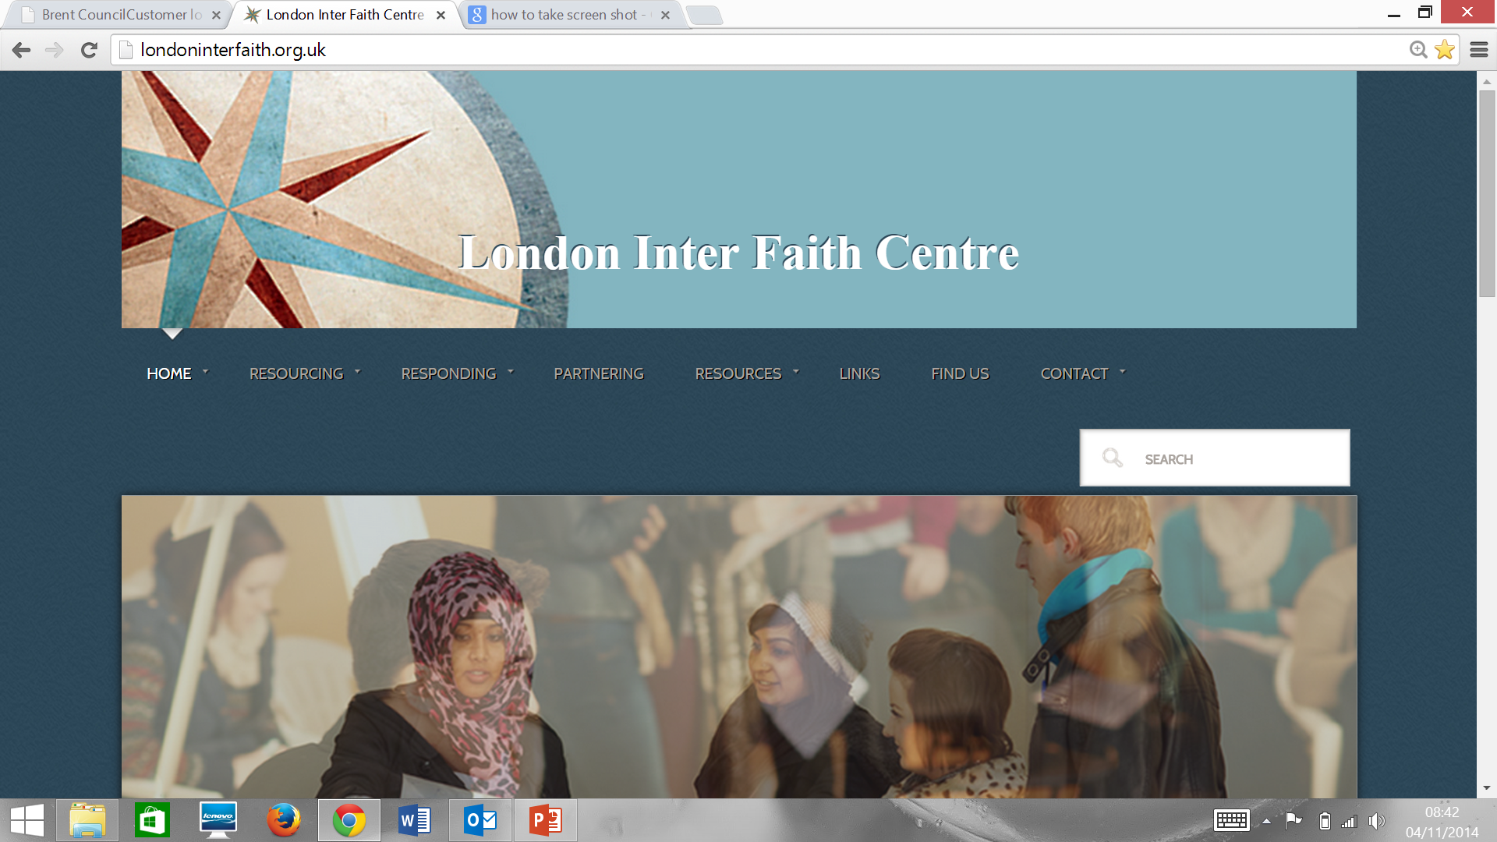

Slide 26
Who We Are
A Christian Centre for inter faith/inter religious engagement, authorised by both the Church of England and the URC at Diocesan/Area level, and part of the Diocesan structure.
supported and resourced by St Anne’s, Brondesbury and St Andrew’s URC , West Kilburn
An independent charity with a trustee board including Duncan Green and Susanne Mitchell (PEN)
Two Co Directors: Maggie Hindley, Laurence Hillel

Slide 27
Our Vision
We aim, by means of talks and courses, the study of scripture, a well stocked library and a website, to resource Christians and others who encounter people of different faiths in their places of work and in their places of abode.
We endeavour to respond to some of the challenges thrown up by our multi faith society through silent prayer and meditation, through meeting with individuals and communities from different faith (and ideological) backgrounds, and through the sharing of stories.
We work side by side with other faith communities in tackling some of the social issues of our day.

Slide 28
What We Offer at Present
Two year Modular Course “Living Together in a Multi Faith World”
Conferences and Seminars
Scriptural Reasoning Groups
Book Group
Resources via website and library

Slide 29
What we can offer
Training Courses/Days
Advice on Near Neighbours Scheme
Resources on aspects of inter faith engagement (books, website)
Advice on any of the issues we have touched upon, and links with PEN, Dr Anne Richards (NRM)

Slide 30
Other Activities
Partnering: London Citizens, Near Neighbours
Responding: Silent Prayer, Christian Meditation

Slide 31
What Can London Inter Faith Centre Do to for you?
laurence.hillel@londoninterfaith.org.uk
07801 286819

